Slide 1


One Lens, 360° Life!
Notes:
1

Slide 2



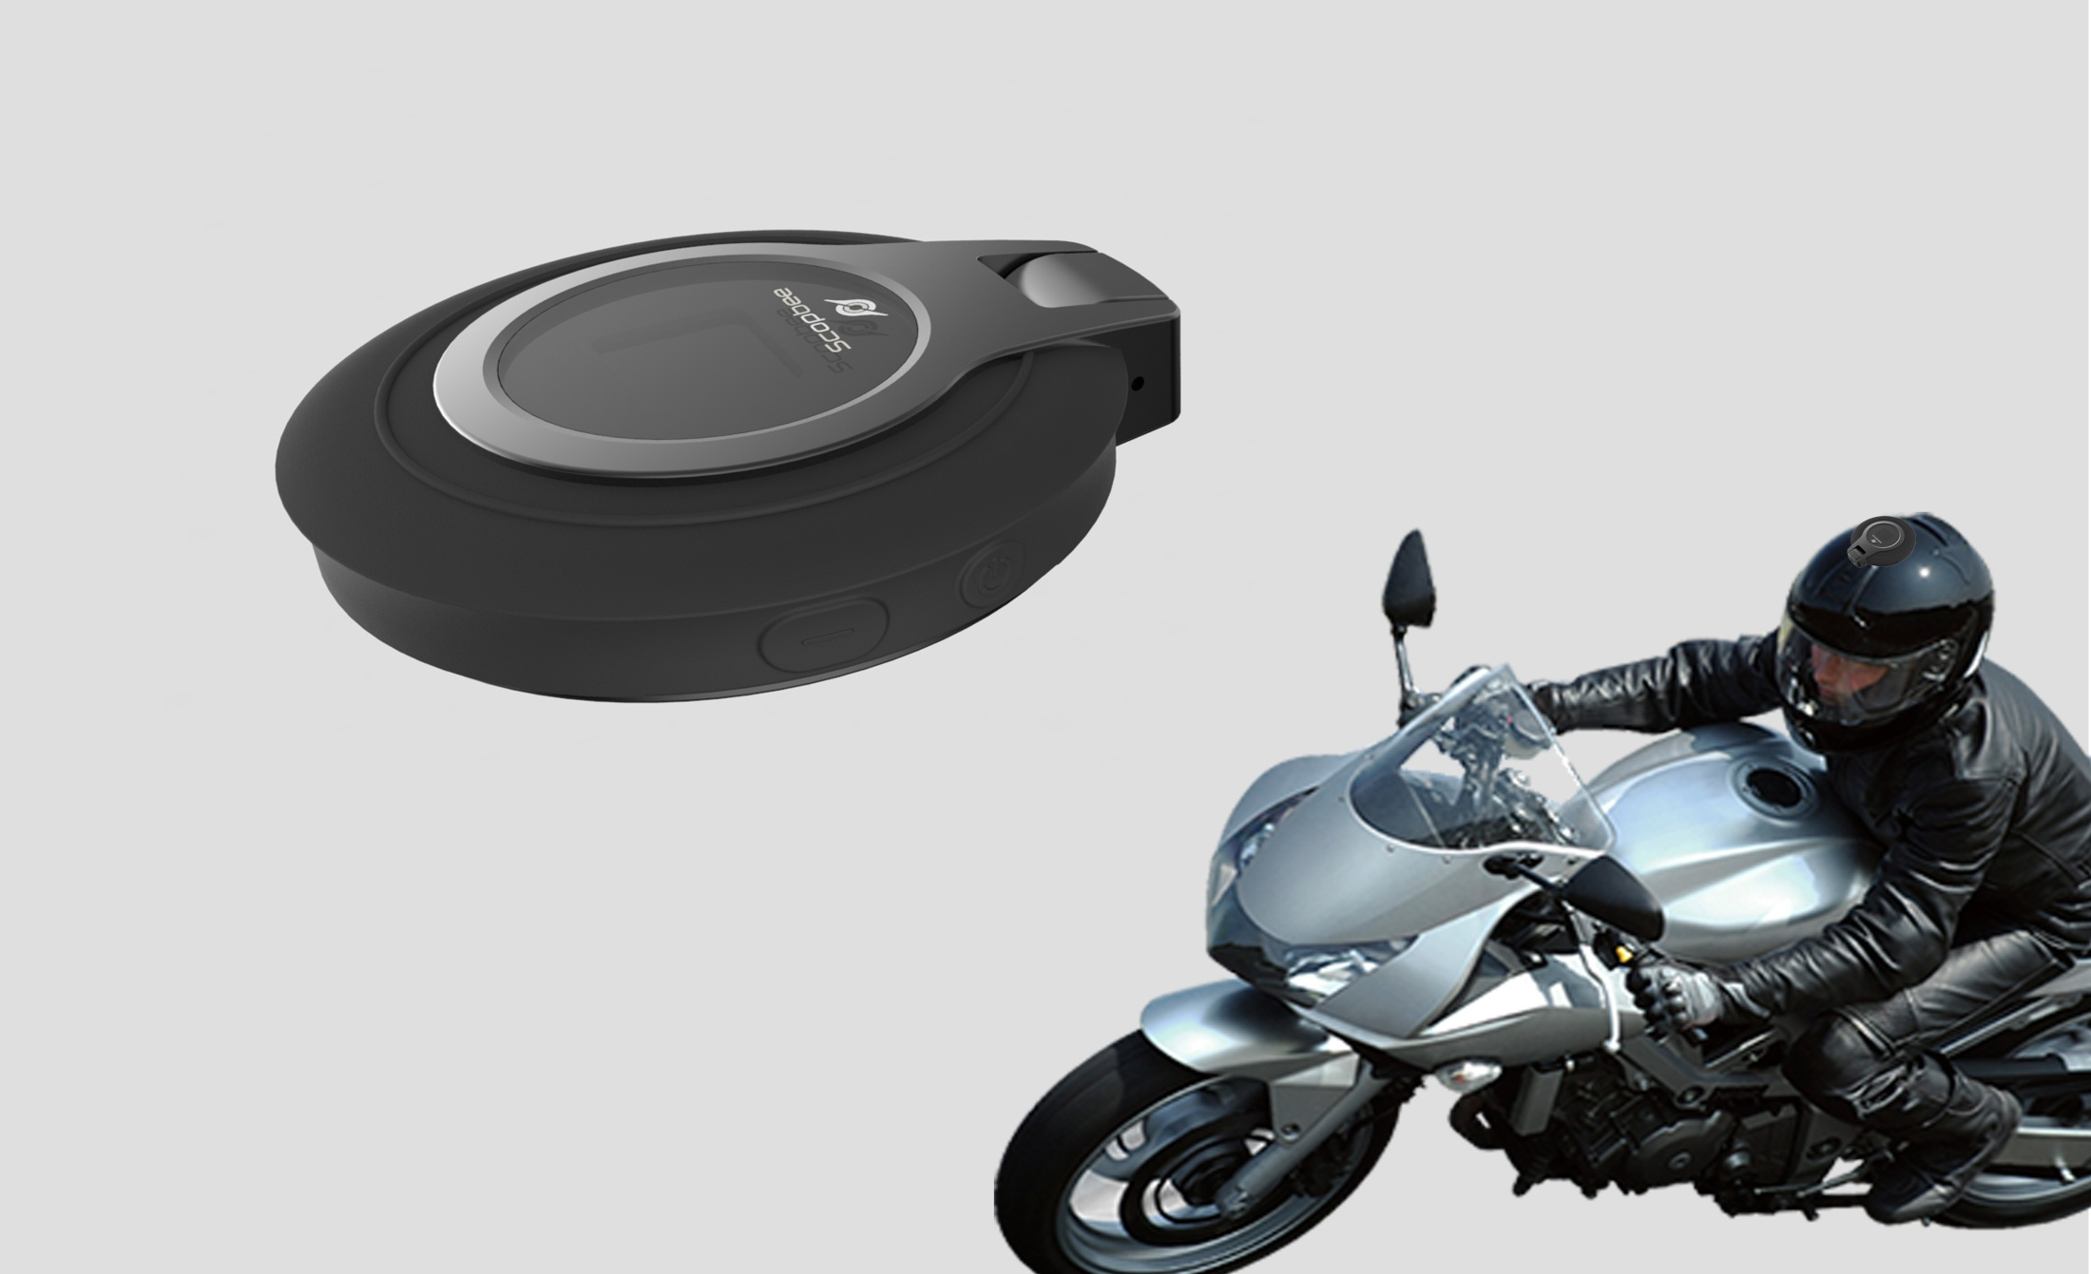
SCOPBEE 360
Affordable Price to Get 360° Life

Slide 3
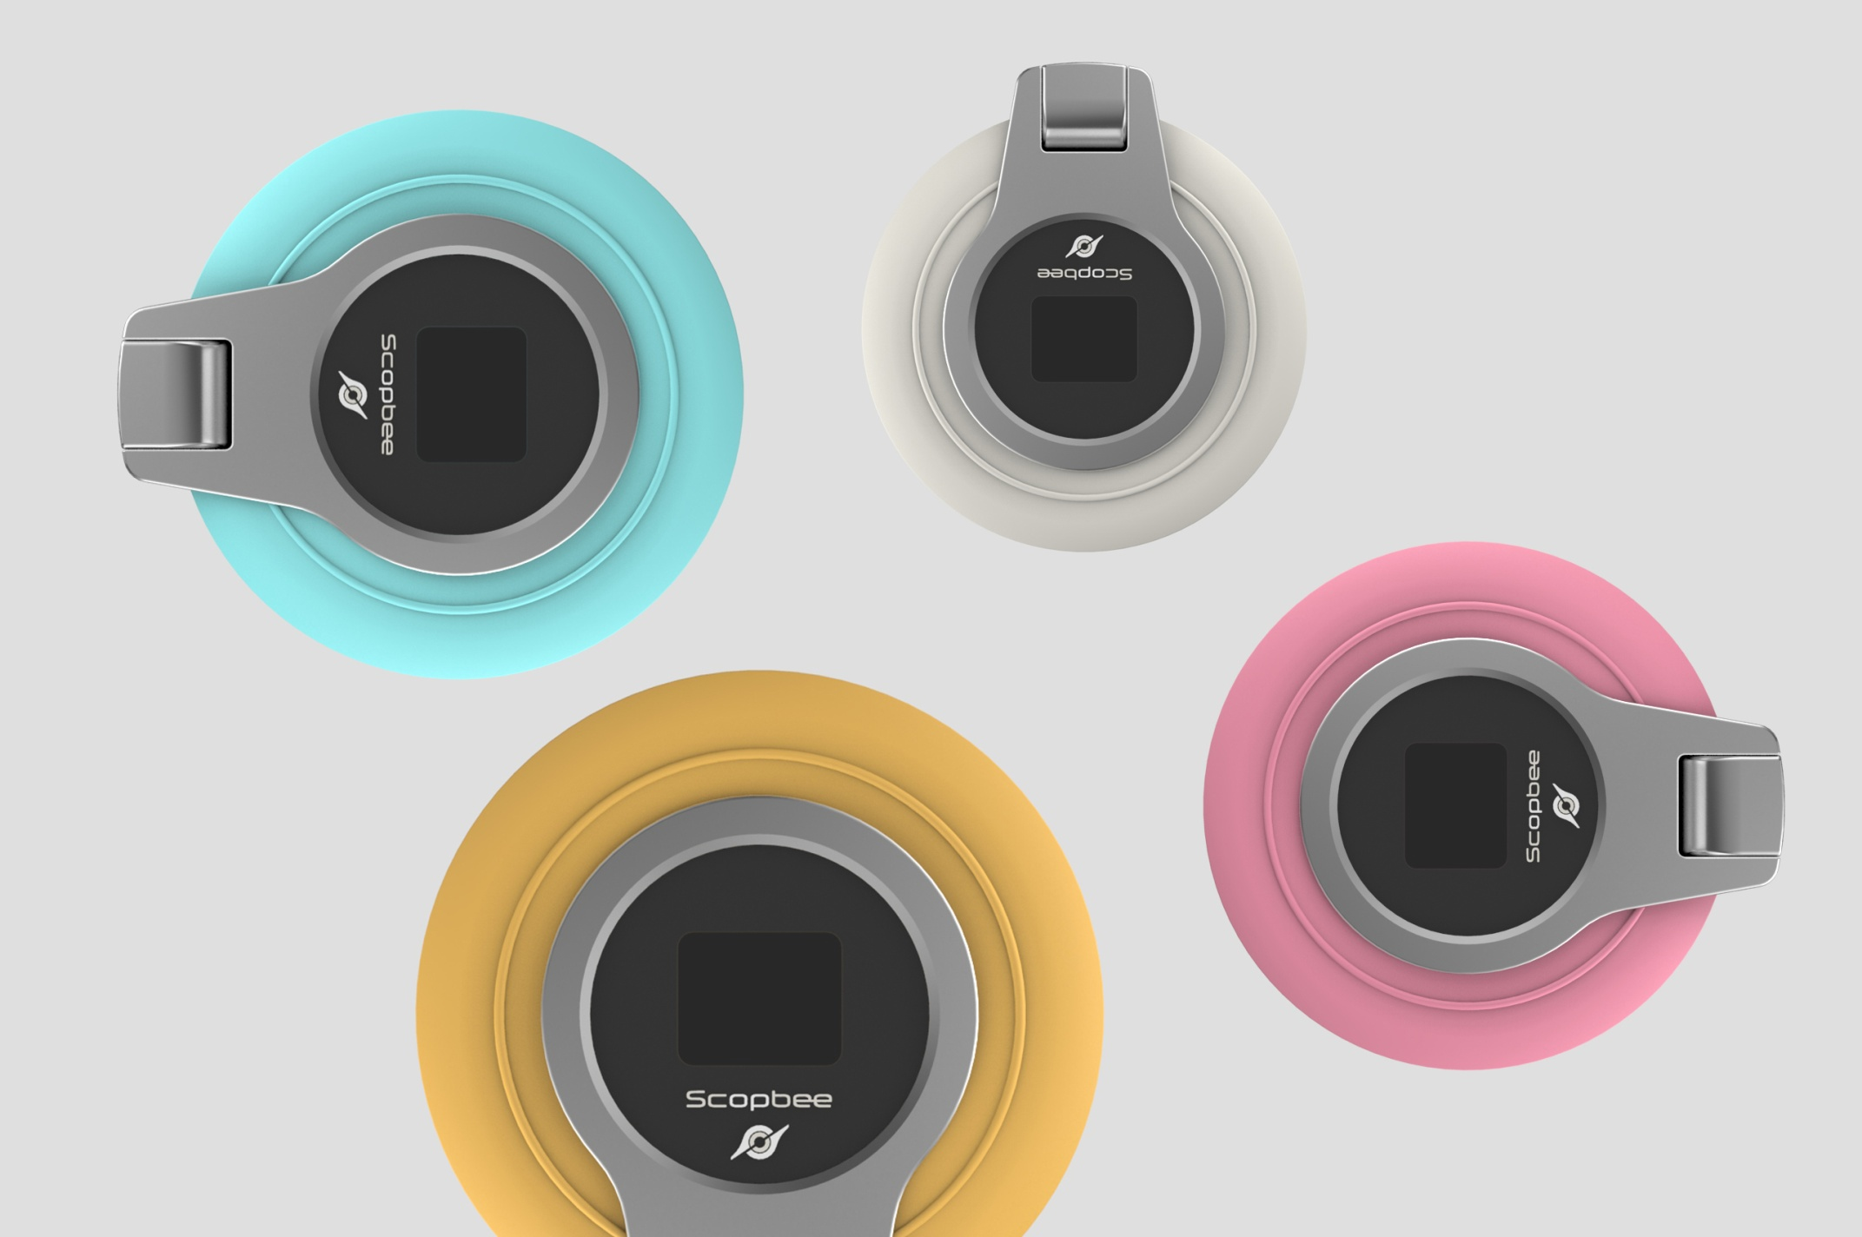
SCOPBEE 360
Various Colors to Enrich Your Style

Slide 4

SCOPBEE 360
Record Outdoor Activities Easily

Slide 5
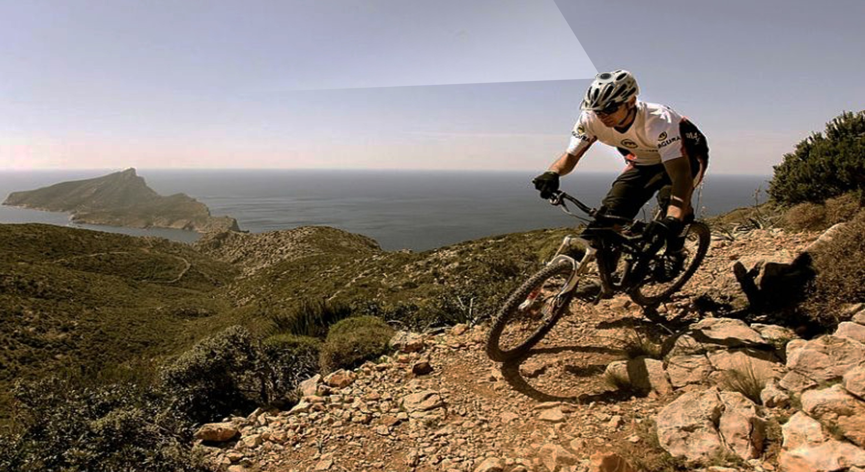
SCOPBEE 360
Record Glorious Time Safely

Slide 6

SCOPBEE 360
Take Magnificent Picture Simply

Slide 7
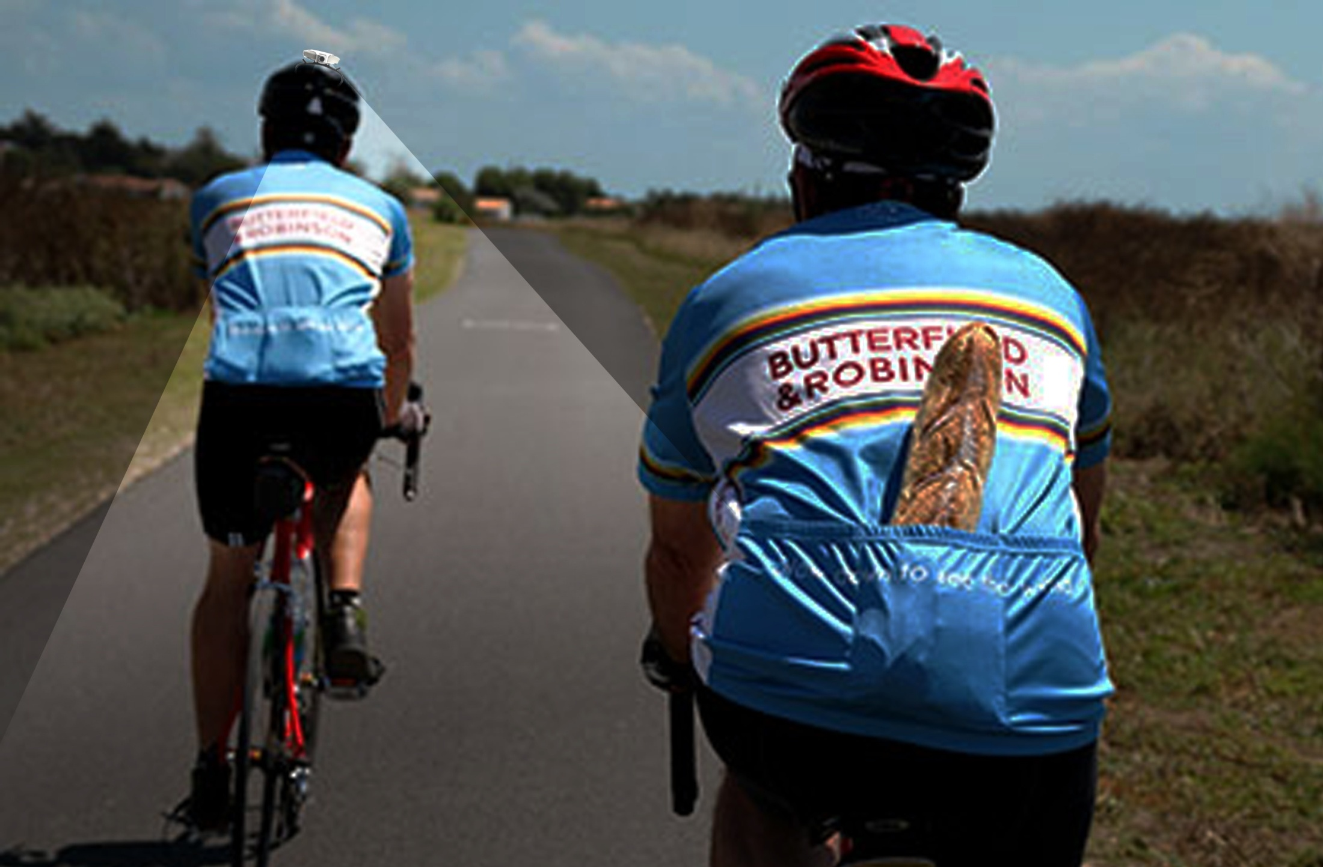
SCOPBEE 360
Cover What You Can’t See

